Slide 1
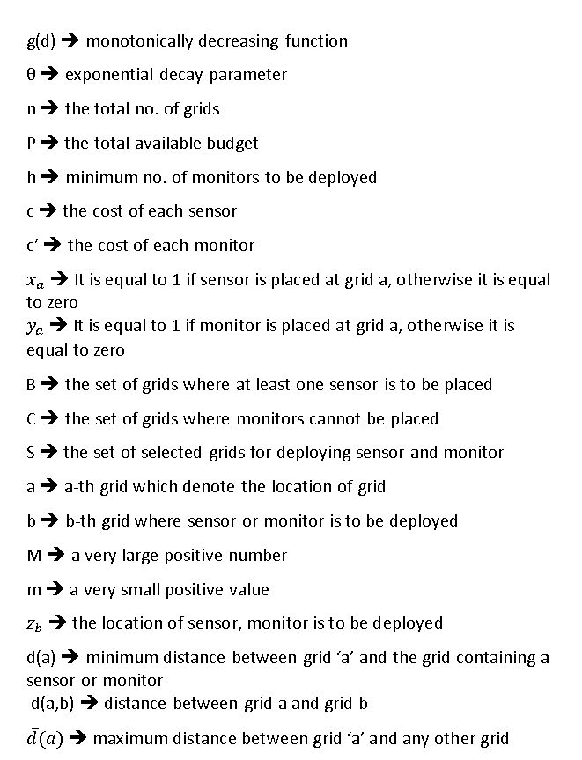
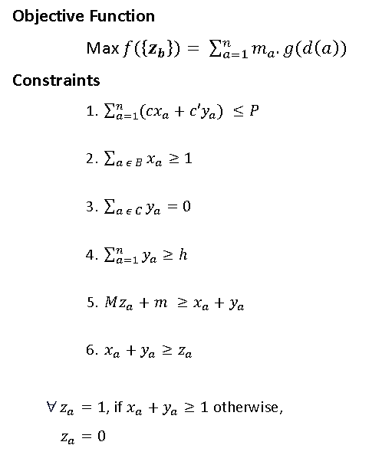
Optimization Formulation

Slide 2
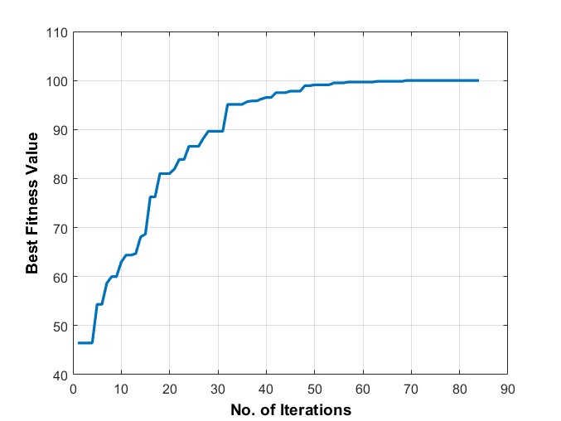
Best Fitness Solution
Input :-
Population Density Data
PM2.5 Emission Data
Cost of Sensors(CS) = $3000
Cost of Monitors(CM) = $122000
Total Available Budget = $313000
No. of Initial Population = 50
Maximum Iteration = 500
Mutation Probability = 0.05
Output :-
Best Fitness Value = 100
Elapsed Time = 7.657428s
1 | 1 | 2 | 1 | 1
1 | 1 | 1 | 1 | 1
1 | 1 | 1 | 1 | 1
1 | 1 | 1 | 1 | 1
2 | 1 | 1 | 1 | 1
1 | 2 | 3 | 4 | 5
6 | 7 | 8 | 9 | 10
11 | 12 | 13 | 14 | 15
16 | 17 | 18 | 19 | 20
21 | 22 | 23 | 24 | 25

Slide 3
Variation in Mutation Probability(Mu)
No. of Population = 50
Maximum Iterations = 500
Mutation Probability | No. of Iteration | Fitness Value
0.02 | 61 | 100
0.05 | 84 | 100
0.06 | 82 | 99.8276
0.07 | 99 | 99.8276
0.08 | 94 | 99.6924
0.09 | 106 | 100
0.1 | 81 | 99.8276

Slide 4
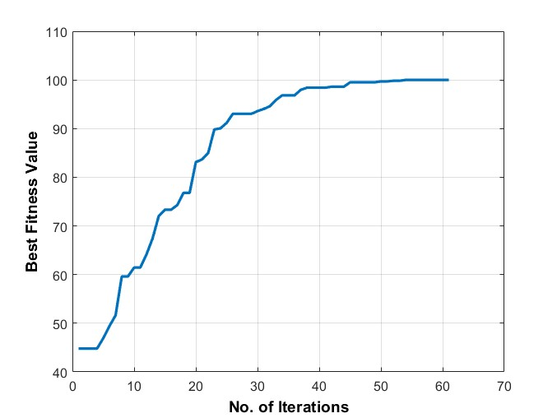
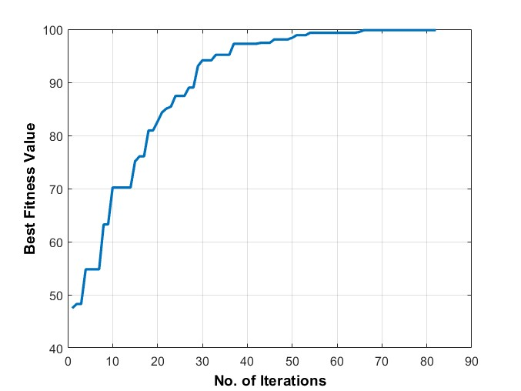
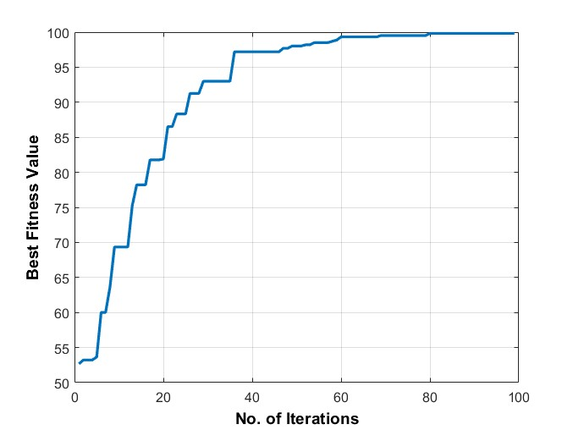
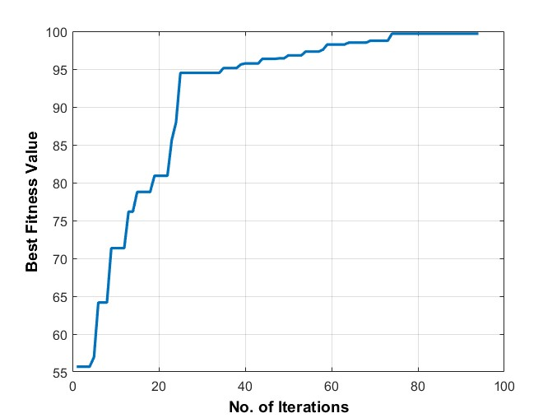
Graph a) Mu = 0.02
Graph b) Mu = 0.05
Graph c) Mu = 0.06
Graph d) Mu = 0.07
Graph e) Mu = 0.08

Slide 5
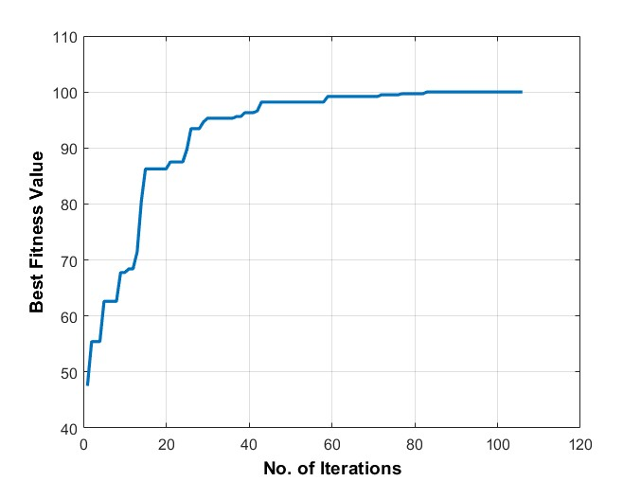
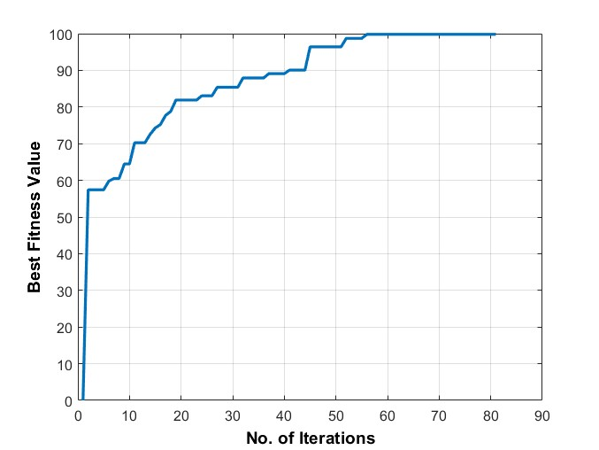
Graph f) Mu = 0.09
Graph g) Mu = 0.1

Slide 6
Variations in No. of Population(nPop)
Maximum Iteration = 500
Mutation Probability = 0.1
No. of Population | Iterations | Fitness Value
10 | 31 | 81.6887
30 | 62 | 96.4957
50 | 81 | 99.8276
70 | 130 | 99.8276
100 | 140 | 100

Slide 7
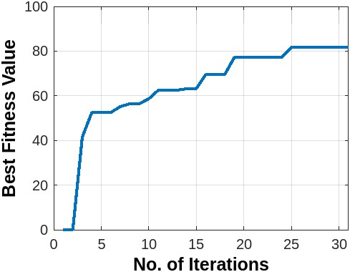
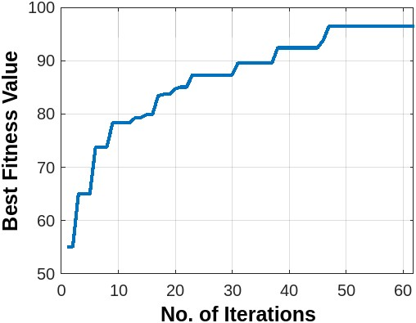
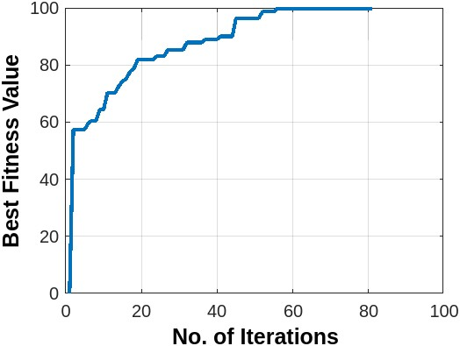
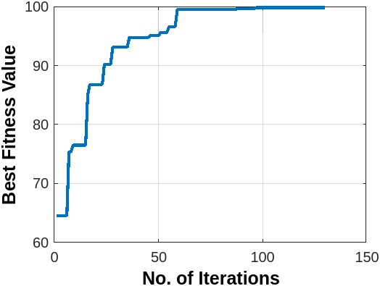
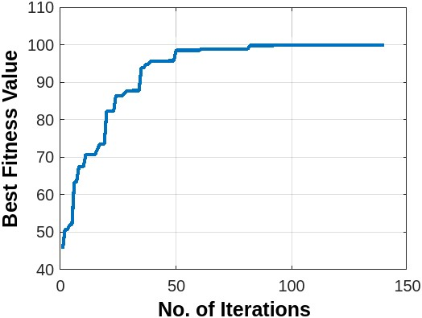
Graph a) nPop = 10
Graph a) nPop = 30
Graph a) nPop = 50
Graph a) nPop = 70
Graph a) nPop = 100

Slide 8
Sensitivity Analysis
No. of Population = 50
Maximum Iterations = 500
Mutation Probability = 0.1
Total Available Budget ($) | Iteration | Fitness Value
247000 | 25 | 45.856
253000 | 28 | 54.0344
259000 | 61 | 67.0917
265000 | 58 | 73.2983
271000 | 84 | 81.4093
277000 | 104 | 85.3143
283000 | 87 | 87.2096
289000 | 136 | 94.1611
295000 | 78 | 94.6737
301000 | 93 | 97.8468
307000 | 76 | 98.7135
313000 | 81 | 99.8276

Slide 9
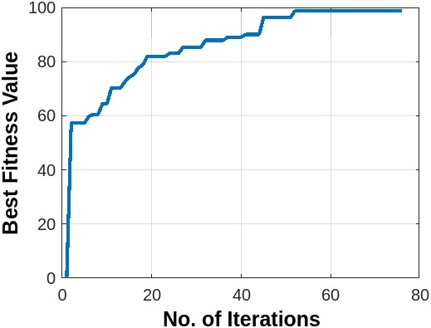
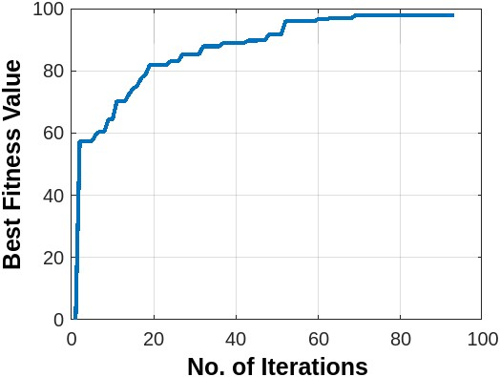
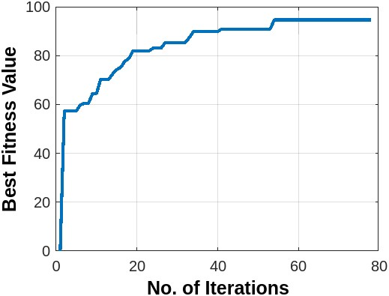
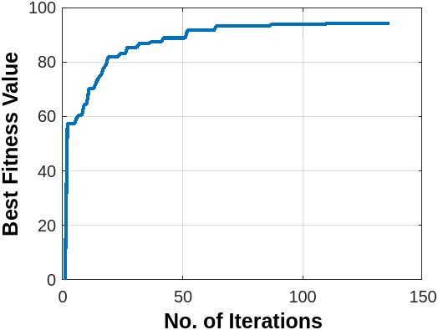
Fig. 313000
Fig. 307000
Fig. 301000
Fig. 295000
Fig. 289000

Slide 10
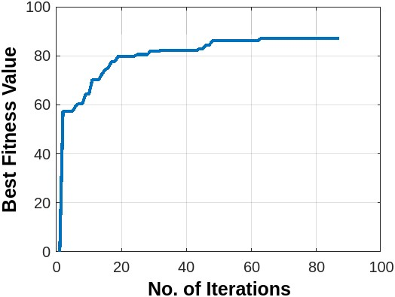
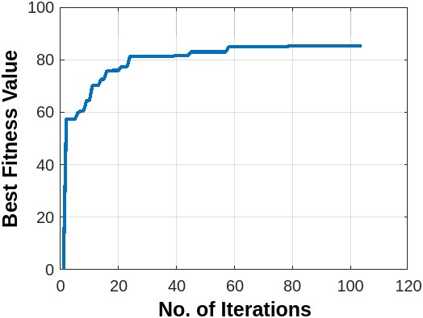
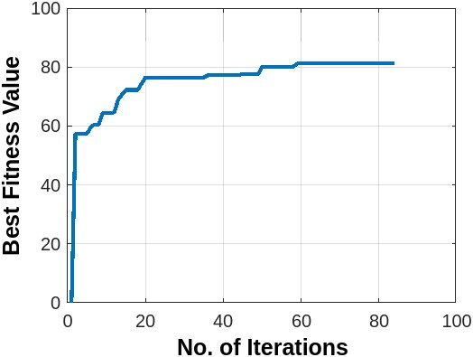
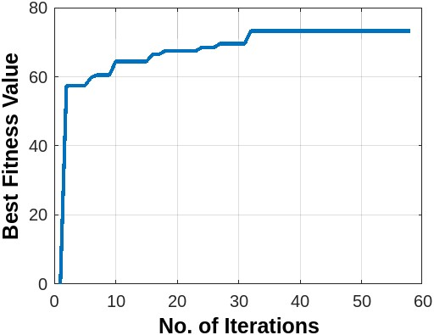
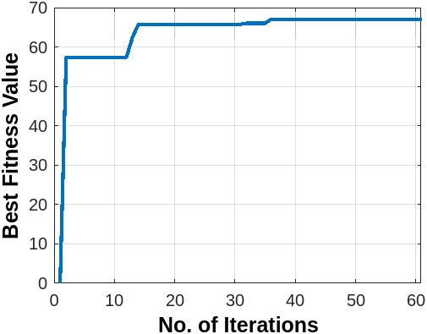
Fig. 283000
Fig. 277000
Fig. 271000
Fig. 265000
Fig. 259000

Slide 11
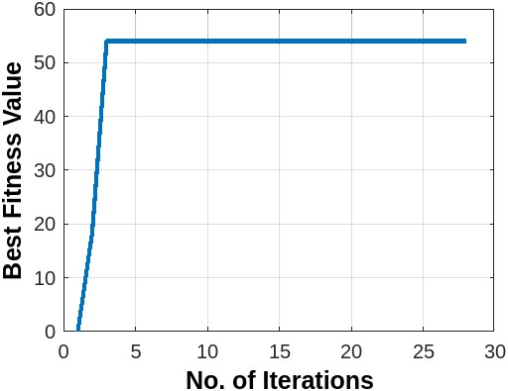
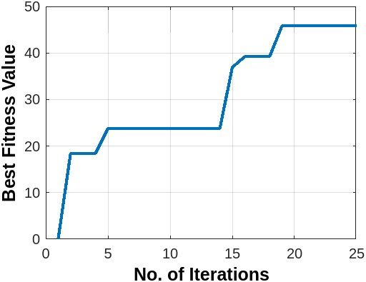
Fig. 253000
Fig. 247000

Slide 12
1 | 2 | 3 | 4 | 5
6 | 7 | 8 | 9 | 10
11 | 12 | 13 | 14 | 15
16 | 17 | 18 | 19 | 20
21 | 22 | 23 | 24 | 25
0 | 2 | 0 | 0 | 2
0 | 0 | 0 | 0 | 0
0 | 0 | 1 | 0 | 0
0 | 0 | 0 | 0 | 0
0 | 0 | 0 | 0 | 0
Grid Position
247000
1 | 1 | 1 | 1 | 2
1 | 1 | 1 | 1 | 1
1 | 1 | 1 | 1 | 1
1 | 1 | 1 | 2 | 1
1 | 1 | 1 | 1 | 1
0 | 2 | 1 | 1 | 1
0 | 1 | 1 | 2 | 1
0 | 1 | 0 | 0 | 0
0 | 0 | 0 | 1 | 0
0 | 0 | 0 | 0 | 1
1 ==> Grid where sensor is to be deployed
2 ==> Grid where monitor is to be deployed
0 ==> Grid where neither sensor nor monitor is to be deployed
313000
271000

Slide 13
Greedy Algorithm
Input :-
Population Density Data
PM2.5 Emission Data
Cost of Sensors(CS) = $3000
Cost of Monitors(CM) = $122000
Total Available Budget = $313000
Output :-
Objective Function Value = 99.8276
Elapsed Time = 2.324170s
1 | 1 | 1 | 1 | 1
1 | 1 | 2 | 1 | 1
1 | 2 | 1 | 1 | 1
1 | 1 | 1 | 1 | 1
1 | 1 | 1 | 1 | 1
Greedy Algorithm Result
1 | 1 | 1 | 1 | 2
1 | 1 | 1 | 1 | 1
1 | 1 | 1 | 1 | 1
1 | 1 | 1 | 2 | 1
1 | 1 | 1 | 1 | 1
Genetic Algorithm Result

Slide 14
S. No. | Placement Location
1 | 5
2 | 8*
3 | 12*
4 | 2
5 | 10
6 | 9
7 | 3
8 | 13
9 | 4
10 | 7
11 | 11
12 | 1
13 | 16
14 | 14
15 | 6
16 | 17
17 | 15
18 | 18
19 | 21
20 | 19
21 | 24
22 | 22
23 | 20
24 | 23
25 | 25
The Placement location tells us about the place where sensor/ monitor is to be placed in an order.
* ➔ Location of Monitor
1 | 1 | 1 | 1 | 1
1 | 1 | 2 | 1 | 1
1 | 2 | 1 | 1 | 1
1 | 1 | 1 | 1 | 1
1 | 1 | 1 | 1 | 1
Total Available Budget = $313000
0 | 0 | 0 | 0 | 1
0 | 0 | 2 | 0 | 0
0 | 2 | 0 | 0 | 0
0 | 0 | 0 | 0 | 0
0 | 0 | 0 | 0 | 0
Total Available Budget = $247000

Slide 15
S. No. | Total Available Budget ($) | Iteration | Best Fitness Value (Genetic Alg.) | Elapsed time(s) | Objective Function Value (Greedy Alg.)
1 | 247000 | 25 | 45.856 | 0.468231 | 48.0019
2 | 253000 | 28 | 54.0344 | 0.530030 | 60.9194
3 | 259000 | 61 | 67.0917 | 1.127566 | 72.0055
4 | 265000 | 58 | 73.2983 | 1.069508 | 80.7265
5 | 271000 | 84 | 81.4093 | 1.655436 | 87.2706
6 | 277000 | 104 | 85.3143 | 2.270798 | 92.1534
7 | 283000 | 87 | 87.2096 | 1.964261 | 95.6661
8 | 289000 | 136 | 94.1611 | 3.476246 | 98.1084
9 | 295000 | 78 | 94.6737 | 1.942365 | 99.0471
10 | 301000 | 93 | 97.8468 | 2.428935 | 99.4647
11 | 307000 | 76 | 98.7135 | 2.004290 | 99.7581
12 | 313000 | 81 | 99.8276 | 2.324170 | 100

Slide 16
Computation Time Comparison
Input :-
Population Density Data
PM2.5 Emission Data
Cost of Sensors(CS) = $3000
Cost of Monitors(CM) = $122000
Total Available Budget = $313000
Output :-
Greedy Elapsed Time = 1.46s
GA Elapsed Time = 2.324170s

Slide 18
THANK YOU

Slide 19
Table 1
Grid Position | Longitude | Latitude | Population per sq. km | PM 2.5 (Kt/yr) | P_{i} (%) | e_{i} (%) | m_{i} (%)
1 | 72.77276 | 21.1863 | 44252 | 0.29385 | 4.511822 | 4.75098 | 4.631404
2 | 72.78276 | 21.1863 | 74524 | 0.497288 | 7.598279 | 8.04019 | 7.819236
3 | 72.79276 | 21.1863 | 85060 | 0.700726 | 8.672503 | 11.3294 | 10.00095
4 | 72.80276 | 21.1863 | 66989 | 0.665802 | 6.83003 | 10.7647 | 8.797385
5 | 72.81276 | 21.1863 | 94922 | 0.630877 | 9.678008 | 10.2001 | 9.939044
6 | 72.77276 | 21.1763 | 23631 | 0.199782 | 2.409357 | 3.23009 | 2.819725
7 | 72.78276 | 21.1763 | 50185 | 0.310924 | 5.116736 | 5.02704 | 5.071889
8 | 72.79276 | 21.1763 | 74016 | 0.422065 | 7.546485 | 6.82399 | 7.185237
9 | 72.80276 | 21.1763 | 80964 | 0.393195 | 8.254886 | 6.35721 | 7.30605
10 | 72.81276 | 21.1763 | 86887 | 0.364325 | 8.85878 | 5.89044 | 7.374609
11 | 72.77276 | 21.1663 | 40666 | 0.105715 | 4.146203 | 1.7092 | 2.927703
12 | 72.78276 | 21.1663 | 69841 | 0.12456 | 7.120812 | 2.01389 | 4.567351
13 | 72.79276 | 21.1663 | 65646 | 0.143405 | 6.693101 | 2.31858 | 4.505839
14 | 72.80276 | 21.1663 | 29660 | 0.120589 | 3.024059 | 1.94969 | 2.486873
15 | 72.81276 | 21.1663 | 15504 | 0.097773 | 1.580749 | 1.5808 | 1.580773
16 | 72.77276 | 21.1563 | 29549 | 0.056277 | 3.012742 | 0.90988 | 1.961313
17 | 72.78276 | 21.1563 | 21068 | 0.085151 | 2.14804 | 1.37673 | 1.762383
18 | 72.79276 | 21.1563 | 9487 | 0.114025 | 0.967271 | 1.84357 | 1.405419
19 | 72.80276 | 21.1563 | 2984 | 0.142434 | 0.304241 | 2.30289 | 1.303564
20 | 72.81276 | 21.1563 | 2260 | 0.170843 | 0.230424 | 2.76221 | 1.496316
21 | 72.77276 | 21.1463 | 4267 | 0.006839 | 0.435053 | 0.11057 | 0.27281
22 | 72.78276 | 21.1463 | 2293 | 0.045742 | 0.233789 | 0.73956 | 0.486676
23 | 72.79276 | 21.1463 | 2042 | 0.084646 | 0.208197 | 1.36856 | 0.788378
24 | 72.80276 | 21.1463 | 2393 | 0.16428 | 0.243984 | 2.65609 | 1.450036
25 | 72.81276 | 21.1463 | 1711 | 0.243914 | 0.174449 | 3.94362 | 2.059033
 |  |  | 980801 | 6.185024

Slide 20
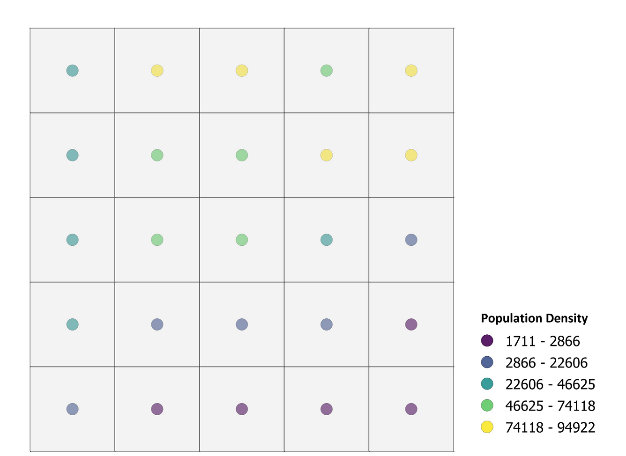
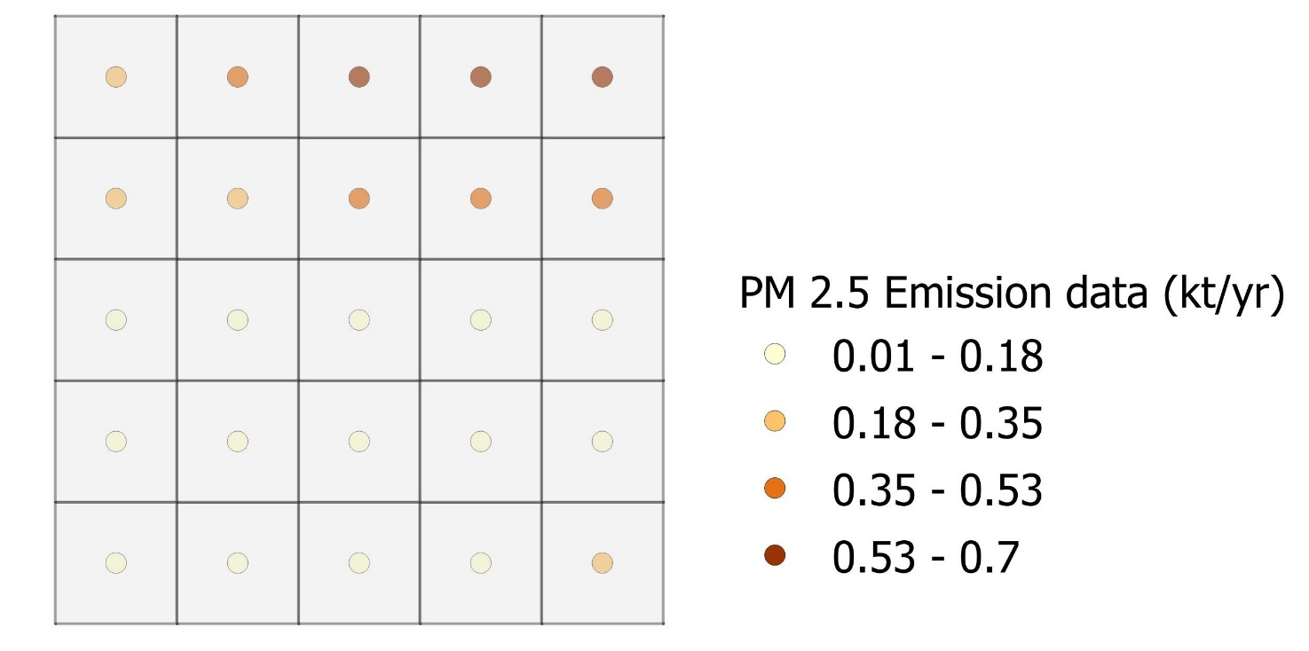
Grid Position in 5 x 5 sq. Km
Population Density per sq. km
1 | 2 | 3 | 4 | 5
6 | 7 | 8 | 9 | 10
11 | 12 | 13 | 14 | 15
16 | 17 | 18 | 19 | 20
21 | 22 | 23 | 24 | 25
Surat Science Centre, CAAQMS

